Slide 1
The summary of work
李光宇

Slide 2
CONTENTS
Background and motivation
This work
Conclusion

Slide 3
PART ONE
Background and motivation

Slide 4
Background and motivation
In recent years，Artificial neural networks (ANNs) have been recognized as a powerful tool in microwave modeling and design . This technique has been applied to parametric modeling of microwave components , optimization of microwave circuits , modeling of nonlinear microwave devices , modeling of RF power amplifiers , and design of microwave filters .

Slide 5
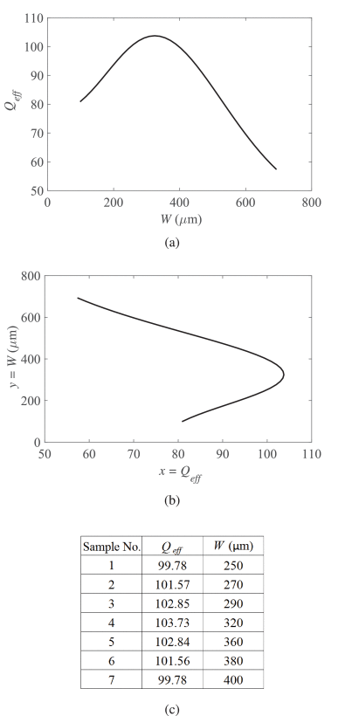
Background and motivation
Now give a example in the paper.
This is what they want,and the Innovation of the paper is that they use a new neural network and
Choose a new loss function.
The new loss function

Slide 6
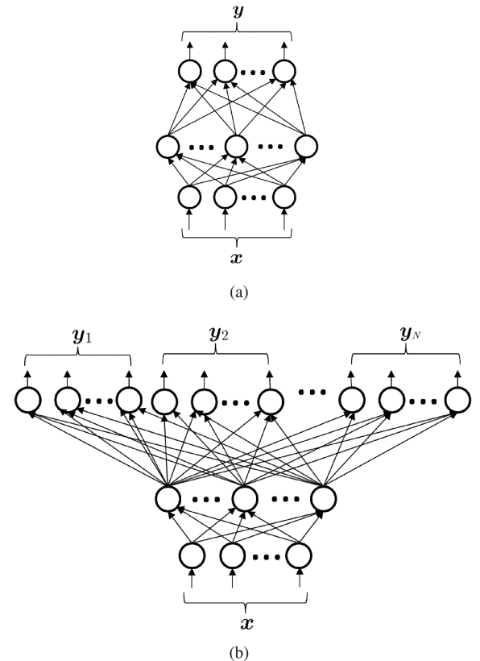
Background and motivation
Now give a example in the paper.
(a) Standard ANN structure for direct inverse modeling of a micrelectricalowave component: x is an n -vector containing the inputs that are usually the parameters. y is an m -vector containing the outputs that are usually the physical or geometrical parameters.
(b) their proposed multivalued neural network inverse modeling technique can associate a single set of electrical parameters with multiple sets of geometrical or physical parameters. x contains the inputs that are usually the electrical parameters. yi is the i th value of proposed inverse model. Each value yi is an m -vector containing all the physical or geometrical parameters defined in the direct inverse modeling technique, i=1,2,…,N . The total number of output neurons in our proposed structure in (b) is N⋅m

Slide 7
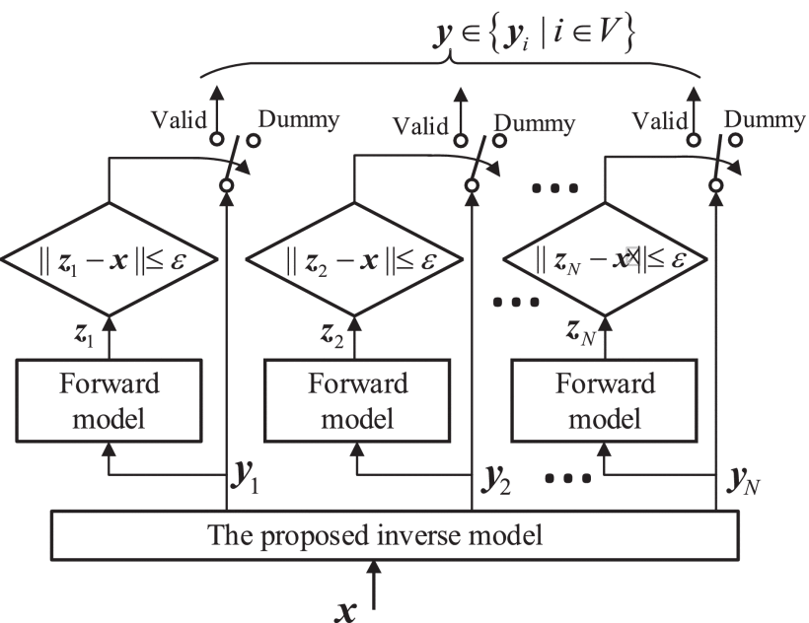
Background and motivation
Now give a example in the paper.
This picture shows how they finish the inverse model

Slide 8
Background and motivation
References
01
Chao Zhang , Jing Jin, WeicongNa , Qi-Jun Zhang ”Multivalued Neural Network Inverse Modeling and Applications to Microwave Filters” , IEEE Transactions on Microwave Theory and Techniques:2018
02
Masataka Ohira ; Ao Yamashita ; Zhewang Ma ; Xiaolong Wang“A novel eigenmode-based neural network for fully automated microstrip bandpass filter design”, 2017 IEEE MTT-S International Microwave Symposium (IMS)
03
Shao-Hua Zhoul ; Hai-Peng Fu ; Jian-Guo Ma ; Qi-Jun Zhang”A Neural Network Modeling Approach to Power amplifiers Taking into Account Temperature Effects”,2018 IEEE/MTT-S International Microwave Symposium - IMSYear: 2018
04
F. Feng, V.-M.-R. Gongal-Reddy, C. Zhang, J. Ma, Q.-J. Zhang, "Parametric modeling of microwave components using adjoint neural networks and pole-residue transfer functions with EM sensitivity analysis", IEEE Trans. Microw. Theory Techn., vol. 65, no. 6, pp. 1955-1975, Jun. 2017.

Slide 9
PART TWO
This work

Slide 10
Coupling martix
This work
Show the physicial model
Ms1 | Ms2 | Ms3 | M11 | M22 | M33
l₁ | l₂ | g | l_{q}
l₁ (mm) | l₂ (mm) | g (mm) | l_{q} (mm)
32.5~35.5 | 32.5~35.5 | 0.5~3.5 | 11.0~15.0

Slide 11
This work
In order to accomplish the regression problem ,I use three methods: Multivariable linear regression , Support Vector Machine - Regression (SVR) and Convolution Neural Network (CNN).

Slide 12
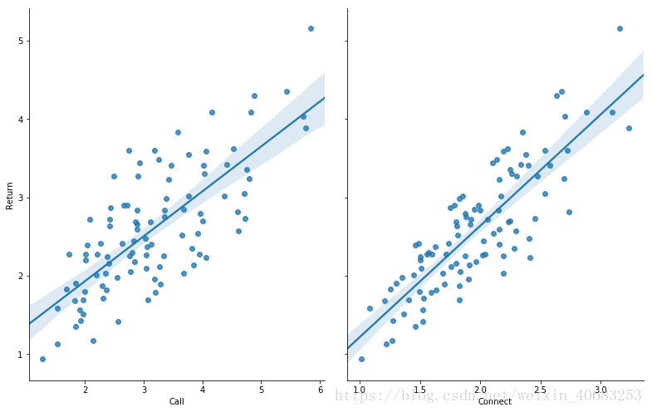
This work
Multivariable linear regression

Slide 13
This work
Support Vector Machine - Regression (SVR)

Slide 14
This work
Non-linear SVR
SVR
Kernel functions

Slide 15
This work
Please admit me introduce some knowledge about Convolution Neural Network (CNN).The CNN includes Input Layer, Convolution Layer,Pooling Layer, Non-linearity Layer and Fully Connected Layer.Next I will introduce them in details.

Slide 16

This work
Convolution layer
Maxpooling layer

Slide 17
Non-linearity Layer
This work
ReLU(Rectified Linear Unit)

Slide 18
This work
Some tricks
Dropout
padding

Slide 19
This work
Evaluation of different methods
 | MSE | MAE | R²
CNN | 0.005290 | 0.053842 | 0.994879
SVM | 0.019779 | 0.090042 | 0.979300
Linear Regression | 0.106104 | 0.230925 | 0.891416

Slide 20
This work
The EM Circuit simulation in different methods

Slide 21
PART THREE
Conclusion

Slide 22
Conclusion
Finish the regression problem and raise a new idea that use the CNN do the inverse modeling.Then compare the result with other machine learning meth-ods .Prove the CNN will behave better.

Slide 23
THANKS

